Slide 1
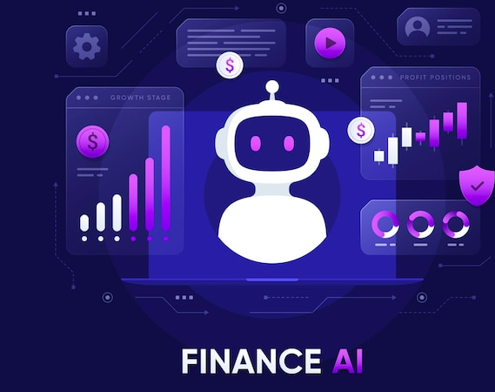
AI-Powered Personal Finance Chatbot
Tejaswini Jammi
Data 606 Capstone Project
University of Maryland, Baltimore County
Professor: Dr Chaojie (Jay) Wang

Slide 2
Problem Statement
Bank statements are unstructured, inconsistent, and hard to analyze
Users manually review long PDFs every month
Expense tracking apps often require manual tagging
Lack of personalized insights for financial decision-making

Slide 3

Motivation
Multiple bank accounts → No unified view
Manual expense management is error-prone
Need for automation + intelligent financial insights
Goal: A system that explains spending the way a human advisor would

Slide 4
Project Objectives
Convert PDF statements into structured data
Use LLMs to extract and classify statement sections
Store normalized data in Postgres
Build a chatbot to answer financial questions using SQL
Provide dashboards for spending and income trends
Enable a Goals page to set savings targets (e.g., emergency fund/trip) and track progress over time

Slide 5
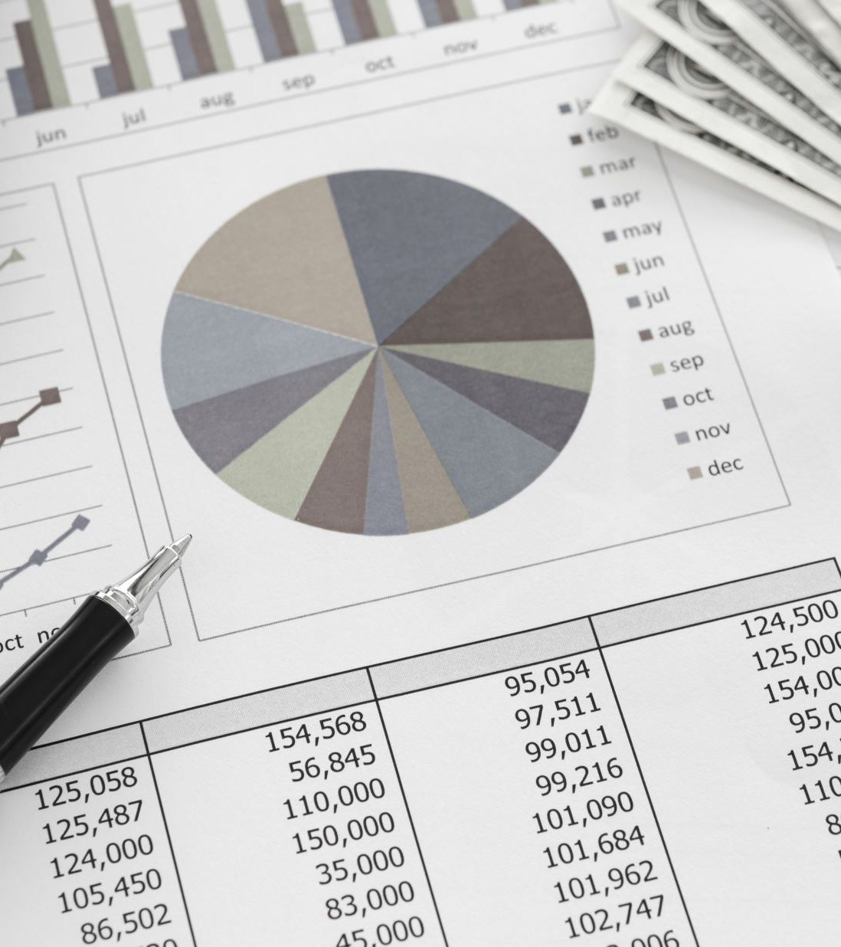
Data
Personal Bank Statements (Either Credit or Debit)

Slide 6
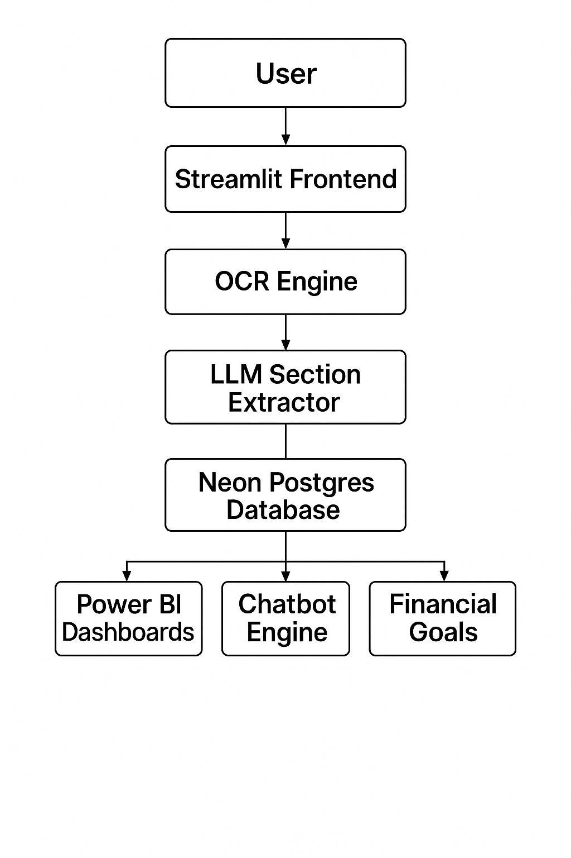
System Architecture (High Level)

Slide 7
Workflow / Data Pipeline
User uaploads bank statement PDF through the Streamlit interface
OCR engine converts PDF statements into raw text
Large Language Model (LLM) extracts and normalizes statement sections
Cleaned and structured data is stored in a PostgreSQL database
Chatbot engine queries database views to answer user financial questions
Dashboards retrieve aggregated data to visualize spending and income trends
Goals module leverages stored transaction data to track user-defined financial goals and progress

Slide 8
Key Challenges Addressed
Bank statements are unstructured and inconsistent
Debit and credit statements follow different formats
Transaction descriptions span multiple lines
Vendors and categories are not standardized
Users cannot query PDFs using natural language

Slide 9

System Design Approach
Modular pipeline separating extraction, storage, and analytics
Combination of OCR, LLMs, and rule-based validation
Normalized database schema to support both chat and dashboards
SQL views designed specifically for reliable question answering

Slide 10
Chatbot Intelligence Flow
User asks a natural language financial question
LLM translates the question into a SQL query
Query runs on curated database views
Results converted into a concise, human-readable response

Slide 11
Analytics & Dashboards
Monthly income vs expense trends
Category-wise and vendor-wise spending analysis
Interactive dashboards for financial exploration
Consistent data source shared with chatbot

Slide 12
Financial Goals Module
Users define savings or spending goals
Goals linked to historical transaction data
Progress tracked over time
Encourages data-driven financial planning

Slide 13
End-to-End User Experience
Upload statements
Ask financial questions
Explore dashboards
Track financial goals
All within a single application

Slide 14
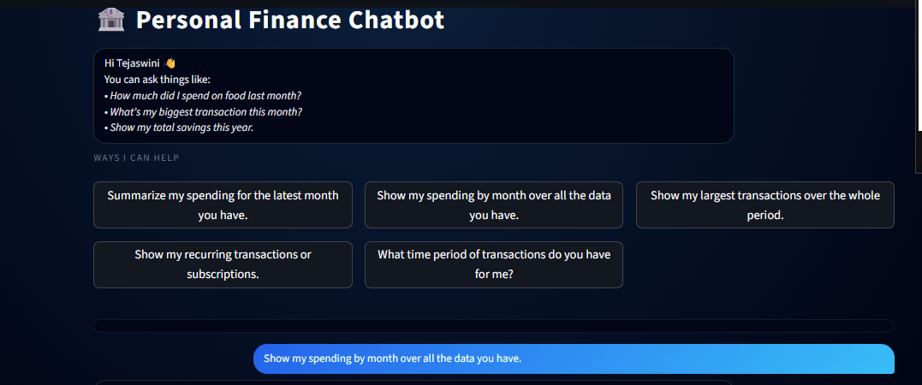
Modules of the Chatbot

Slide 15
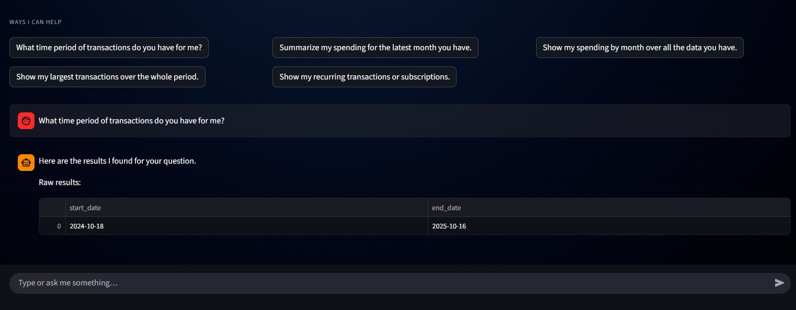

Slide 16
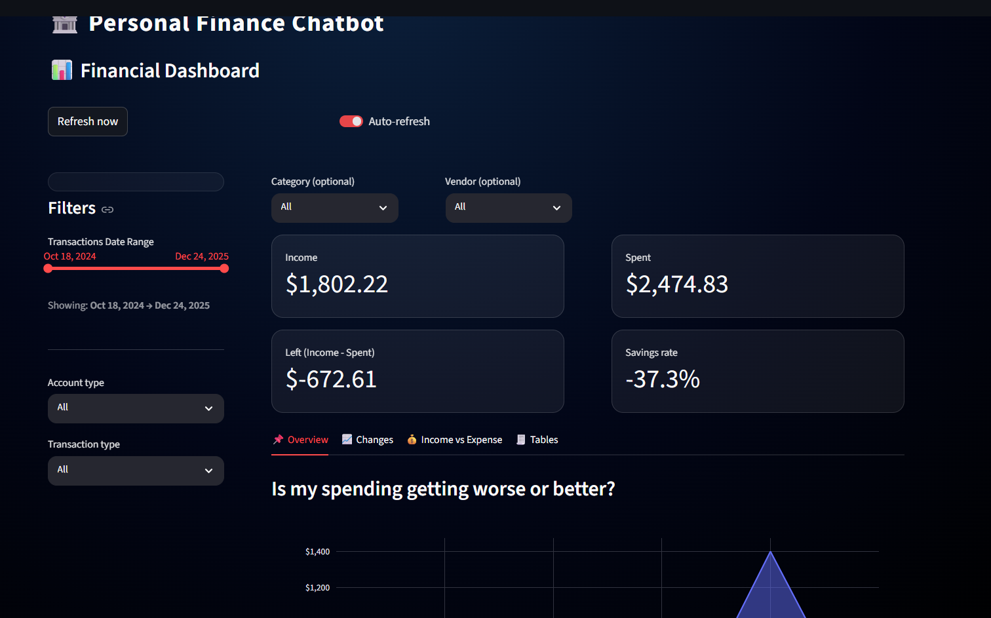

Slide 17
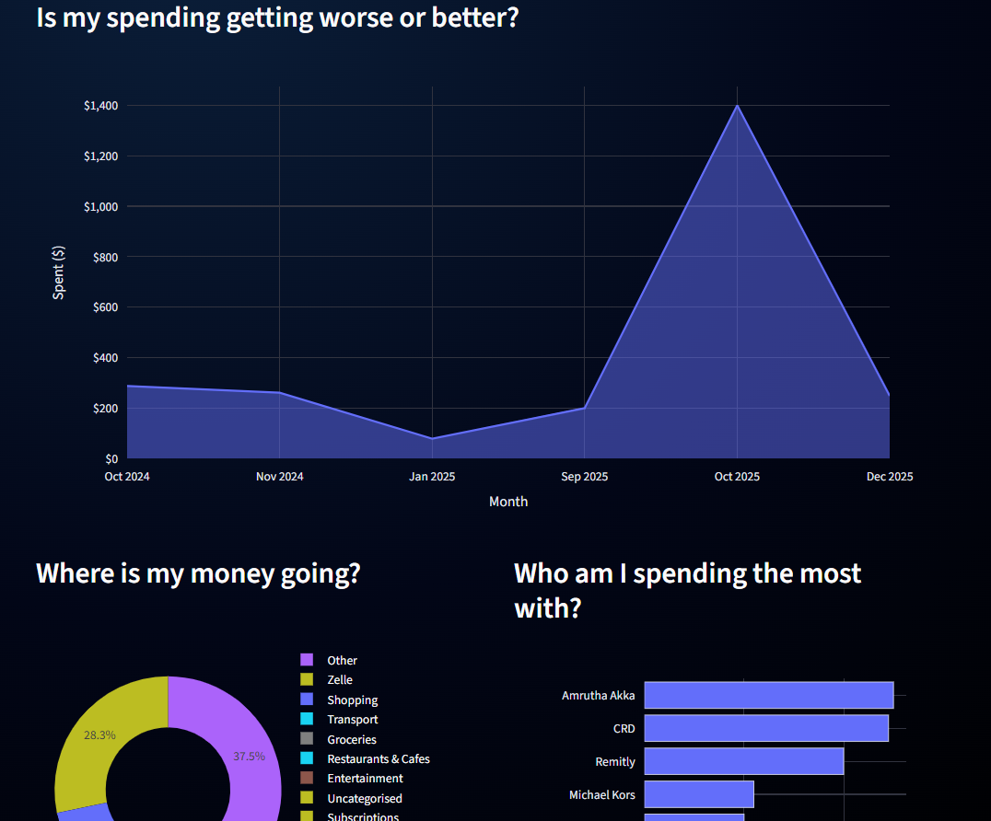

Slide 18
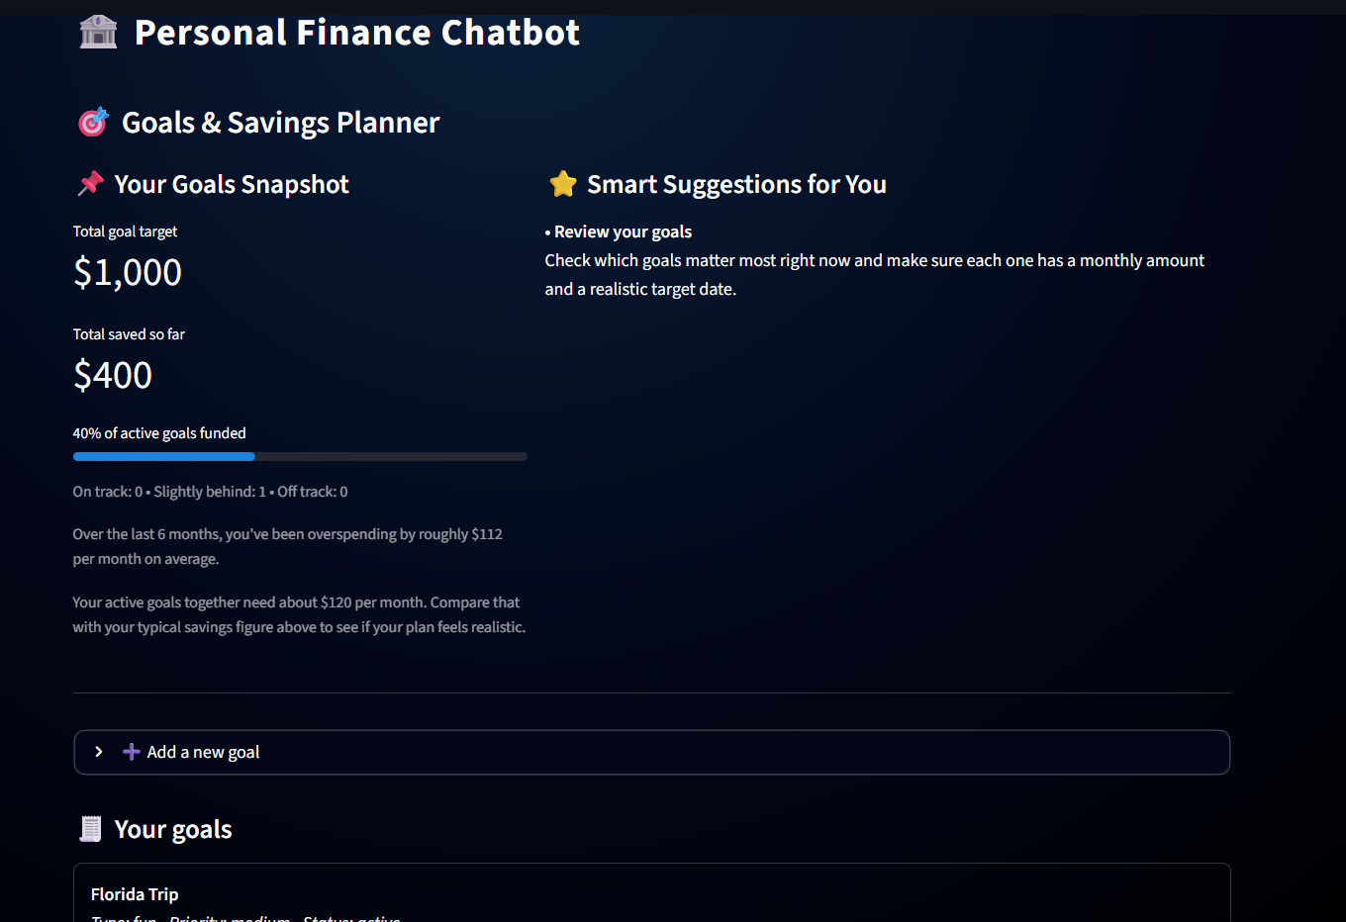

Slide 19
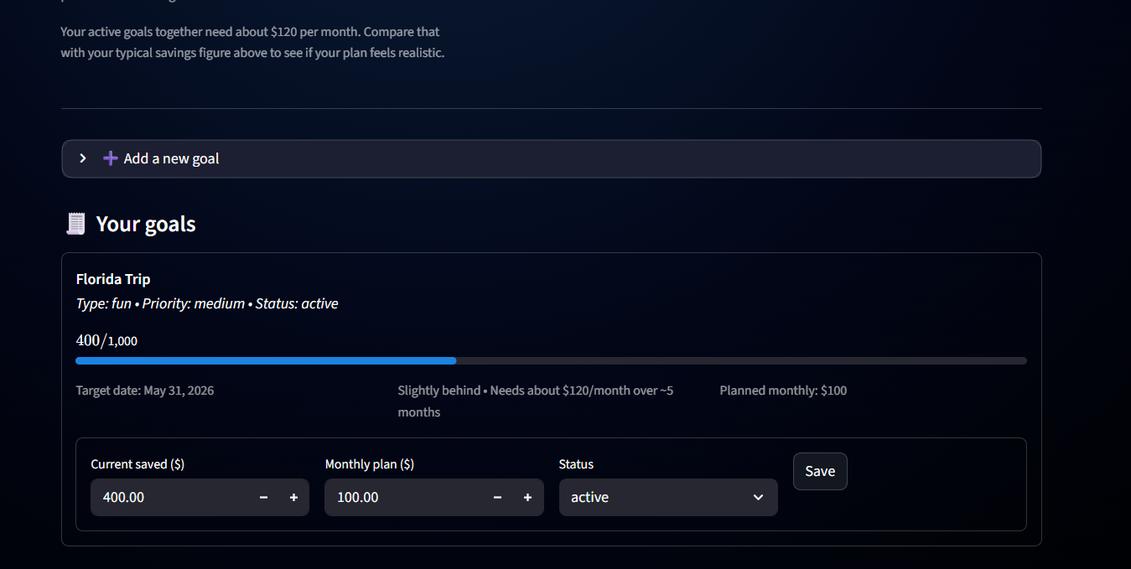

Slide 20
Results & Impact
Converts unstructured PDFs into queryable data
Enables financial insights without SQL knowledge
Integrates chat, dashboards, and goal tracking
Scalable to multiple statements and users

Slide 21
Limitations
OCR accuracy depends on statement quality
Currently supports limited bank formats
No real-time transaction ingestion

Slide 22
Conclusion & Future Work
Demonstrated an end-to-end AI-powered finance assistant
Combines OCR, LLMs, and databases effectively
Future work:
Investment insights
Budget recommendations
Multi-bank support

Slide 23
Thank You

